Slide 1
Formal Methods in software engineering
Lecture 05 & 06
Ms. Rabia Iftikhar
rabia.iftikhar@faculty.muet.edu.pk

Slide 2
Outline
Predicate Logic
Binding Variables

Slide 3
Predicate Logic
One of the limitations with the propositional logic is that, while it allows us to argue about individual values, it does not give us the ability to argue about sets of values.
For example we could refer to
the set containing all the people who work in a particular office;
the set of whole numbers from 1 to 10;
the set of the days of the week;
the set of all the breeds of cat in the world.
For the purpose of reasoning about sets of values, a more powerful tool than the propositional logic has been devised, namely the predicate logic.
A predicate is a truth-valued expression containing free variables. These allow the expression to be evaluated by giving different values to the variables. Once the variables are evaluated they are said to be bound.

Slide 4
Predicate Logic- Example
Predicates can be named with either a single letter, or with a word that expresses the meaning of the predicate; the variables are placed in brackets after the name. This is made clear in the following examples:
C(x): x is a cat
Studies(x,y): x studies y
Prime(n): n is a prime number
A statement such as C(x) can be read C of x.

Slide 5
Binding Variables
Predicates such as those above do not yet have a value – they only have a value when the variables themselves are given a value.
There are two ways in which this can be done
By substitution
By quantification

Slide 6
Binding Variables
1. By substitution (giving a value to the variable)
For example, using the above three predicates:
C(Simba): Simba is a cat
Studies(Olawale, physics): Olawale studies physics
Prime(3): 3 is a prime number
The above expressions now have a value of TRUE or FALSE.

Slide 7
Binding Variables
2. By quantification
A quantifier is a mechanism for specifying an expression about a set of values. There are three quantifiers that we can use, each with its own symbol:
The universal quantifier ∀
The existential quantifier ∃
The unique existential quantifier !

Slide 8
Binding Variables
2. By quantification
–The universal quantifier ∀
This quantifier enables a predicate to make a statement about all the elements in a particular set. For example, if M(x) is the predicate x chases mice, we could write:
∀x Cats ● M(x)
This reads For all the x which are members of the set Cats, x chases mice, or, more simply, All cats chase mice.

Slide 9
Binding Variables
2. By quantification
– The existential quantifier ∃
In this case, a statement is made about whether or not at least one element of a set meets a particular criterion.
For example, if, as above, P(n) is the predicate n is a prime number, then we could write:
∃n ● P(n)
This reads There exists an n in the set of natural numbers such that n is a prime number, or, put another way, There exists at least one prime number in the set of natural numbers.

Slide 10
Binding Variables
2. By quantification
–The unique existential quantifier !
This quantifier modifies a predicate to make a statement about whether or not precisely one element of a set meets a particular criterion.
For example, if G(x) is the predicate x is green, we could write
∃!x Cats ● G(x)
This would mean There is one and only one cat that is green. If the set over which the predicate is defined is clearly stated in advance, it can be omitted from the expression

Slide 11
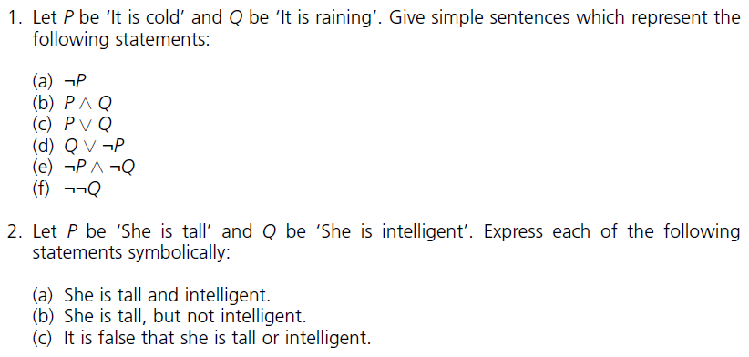
Questions

Slide 12
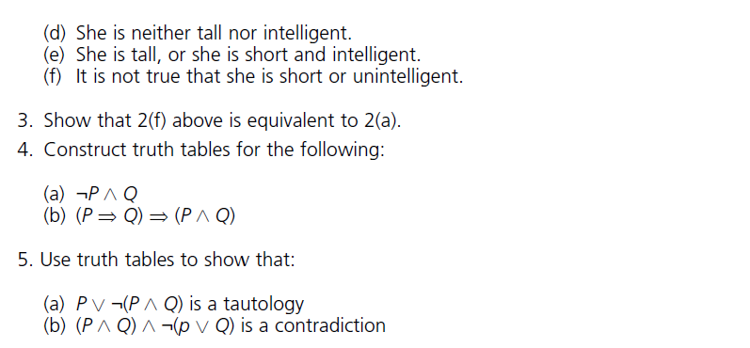
Questions

Slide 13
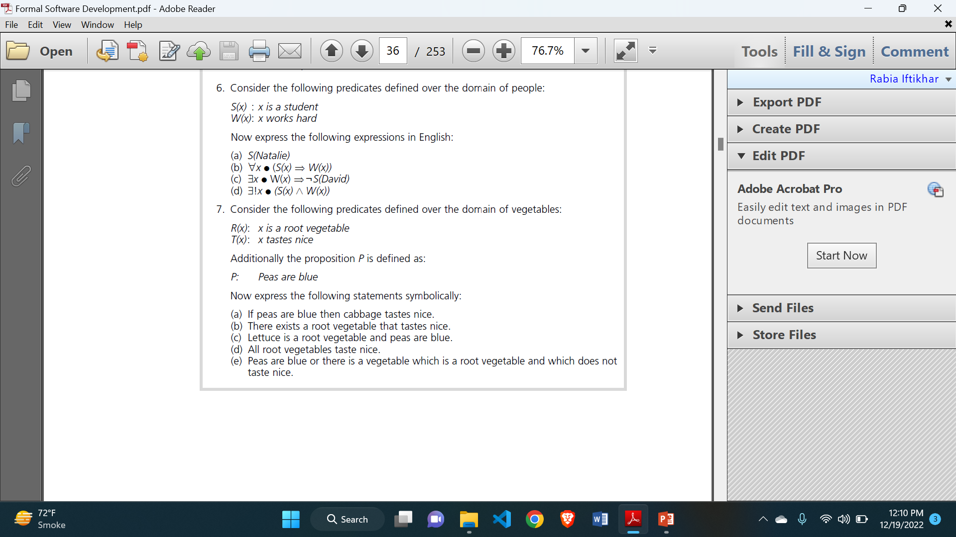
Questions

